Slide 1
GNR-652 PROJECT REPORT
Topic: Implementing paper on LSTM RNN framework for Network Traffic Prediction Matrix
Contributors: Ayushraj Mehrotra - 17D070034
Parth Shettiwar - 170070021
Bhadri Narayanan - 160020118
Athithyan Paramasivan - 17B030031

Slide 2
Feed-forward Neural Networks
No looping or feedback of information, info can travel only in the forward direction.
Can’t be used for time-dependent learning, nor can’t it predict trends based on present.
The computation time is faster but can give rise to vanishing gradient problems

Slide 3
The vanishing gradient problem
Gradient descent is applied for updating the weights, the change being proportional to the derivative if the error w.r.t to the weight.
The gradient can become extremely low, thus converging at a local extrema or not updating the weights at all.
For error functions having gradient less than |1|, the updation might get exponentially slow depending upon the number of layers and the weights might not change at all. Hence very slow learning.

Slide 4
Recurrent Neural Networks
Can be used to process a sequence of inputs and contains feedback loops
Has memory and is affected by previous data, the weights are shared over time.
LSTM is one of the ways for implementing RNN. Others include GRU, Continuous-Time, etc.

Slide 5
LSTM
Our project is based on predicting the network traffic based on the current conditions, LSTM is apt for such problems.
The vanishing gradient problem is avoided in LSTM by of implementation of forget gate as the contribution of each module decreases progressively as we move forward.
Further LSTM improves upon the long term dependency as compared to RNN.
The loss function for the project is taken as MSE.

Slide 6
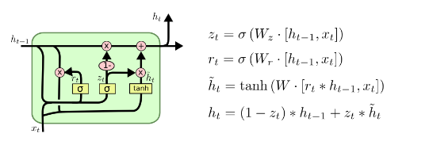
LSTM Algorithm
The algorithm makes use of sigmoid and tanh functions to control the fraction of the memory for each module that needs to be passed.
The first sigmoid layer describes the fraction of the previous component that needs to be let through.
The next tanh+sigmoid layer decides the fraction of the new information (xt) that will be stored.
The final output of the module will be a linear combination of the current and previous module.

Slide 7
Codes
We prepared 4 codes for the project for efficient change of parameters:
Model.py: In this we decided on the model to be used in the network. After few tests ,we finally decided on the 4 layer model.
Data.py: In this we just processed the data suitable to be used for the training of network.
Train.py: The training was implemented here.8000 train and 4000 test cases dataset was taken. We calculated the errors mse, mape, rmse on training dataset.
Final.py: We stored the weights in lstm.h5 and used those weights for the test dataset. We further calculated the mse,mape, mae, rmse on the test dataset. The plots for the true dataset and the predicted values were also included.
An image of the model used was also generated.

Slide 8
Dataset
The dataset was obtained from the Caltrans Performance Measurement System (PeMS 5 minute interval traffic flow data). Data were collected in real time from individual detectors spanning the freeway system across all major metropolitan areas of the State of California.
The train data is 8000 while the test data is 4000.

Slide 9
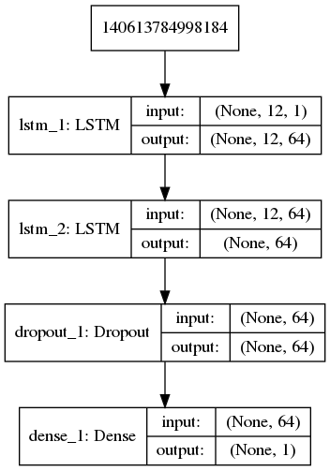
The 4 layer Model

Slide 10
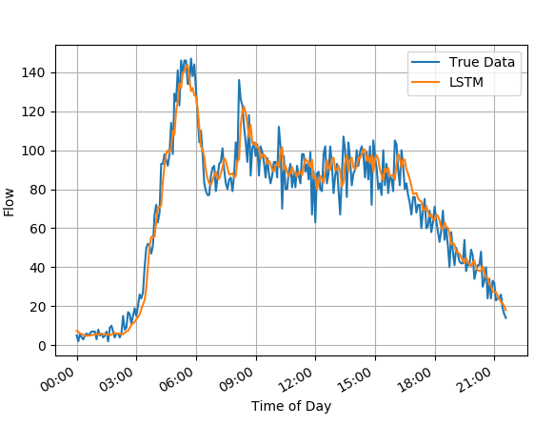
Our implementation
Changing Window Sizes
We obtained results for 3 different window size of our LSTM code.
Window size 12: optimum error value was obtained

Slide 11
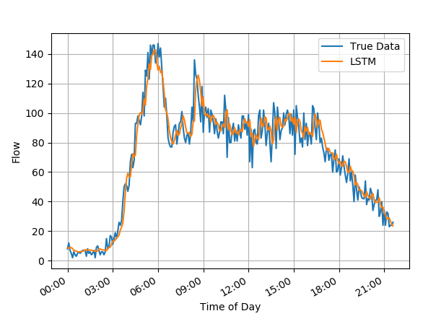
Window size 15: more deviation from the previous case was obtained

Slide 12
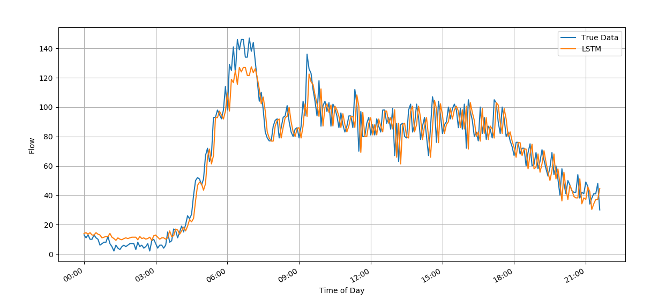
Window size 1: The network now essentially behaves as RNN. Clearly the error has increased from the true data, thus suggesting LSTM is a more accurate model.

Slide 13
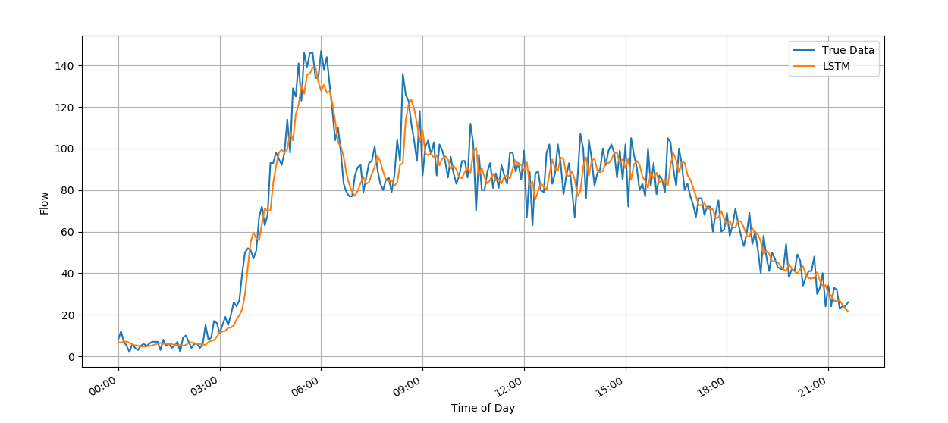
Changing the dropout values
In the previous case, the dropout value was 0.2. On increasing it to 0.5, the predicted value moves towards greater fitting and hence the error from the true data has reduced.

Slide 14
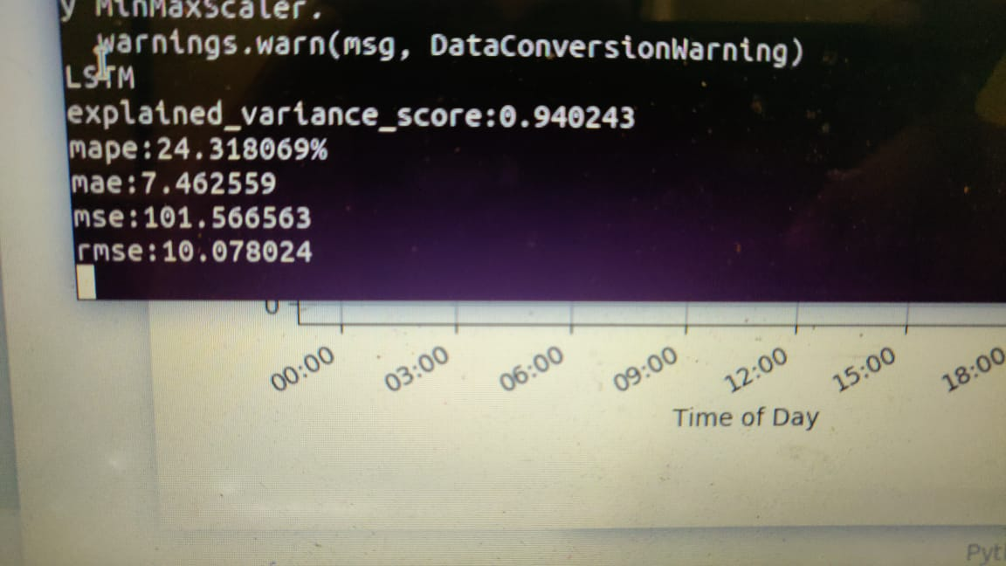
Error values obtained for 0.2 dropout.

Slide 15
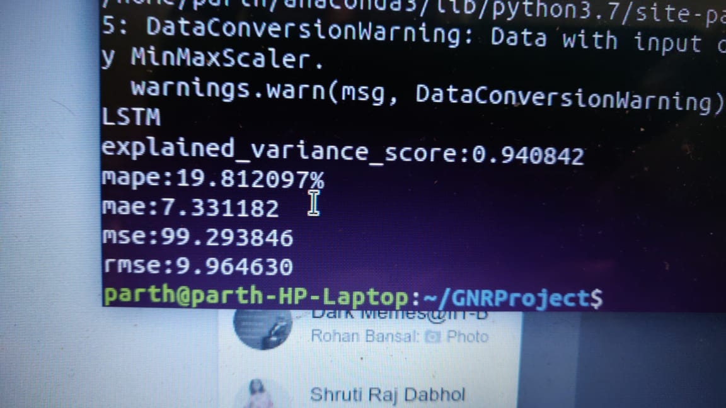
Different error values obtained for 0.5 dropout.We can clearly the error has decreased.

Slide 16
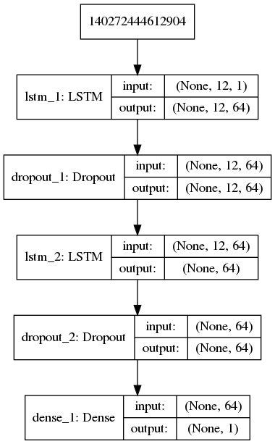
5 layer model

Slide 17
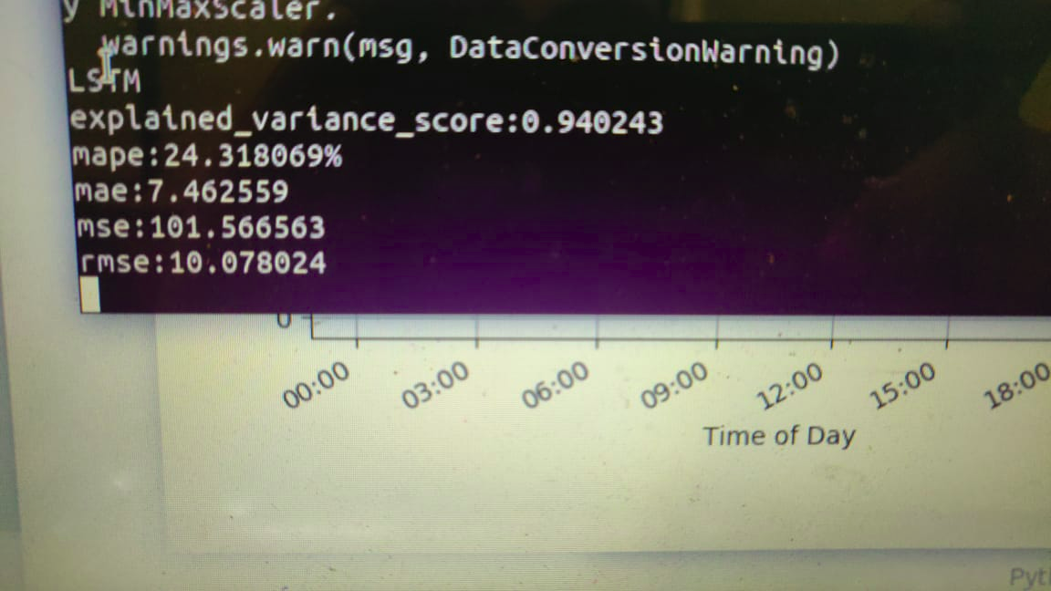
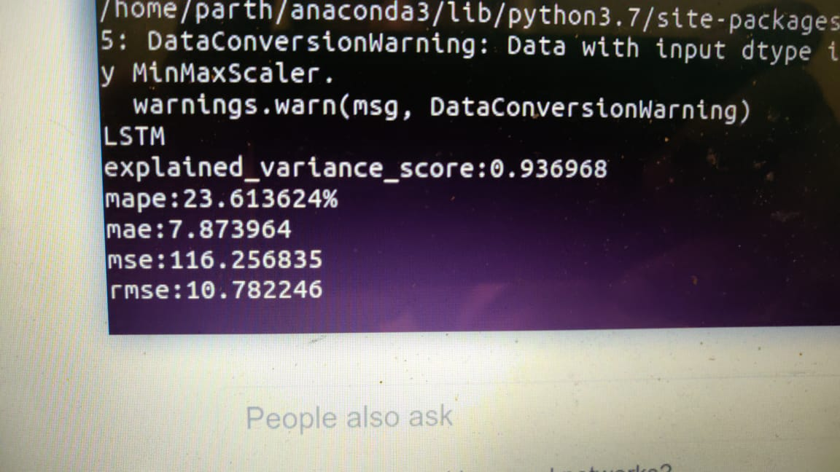
Test error for a 5 layer model. MSE increased a little while there was some reduction in mape error.
4 layer model
5 layer model

Slide 18
Summary
Following is the summary of results:
1)Changing window sizes - minimum error for window=12
Huge error for size =1
2)Increasing dropout to 0.5 decreases the error.
3)Changing to 5 layer model increases mse a little but decreases mape error.

Slide 19
THANK YOU

